Slide 1
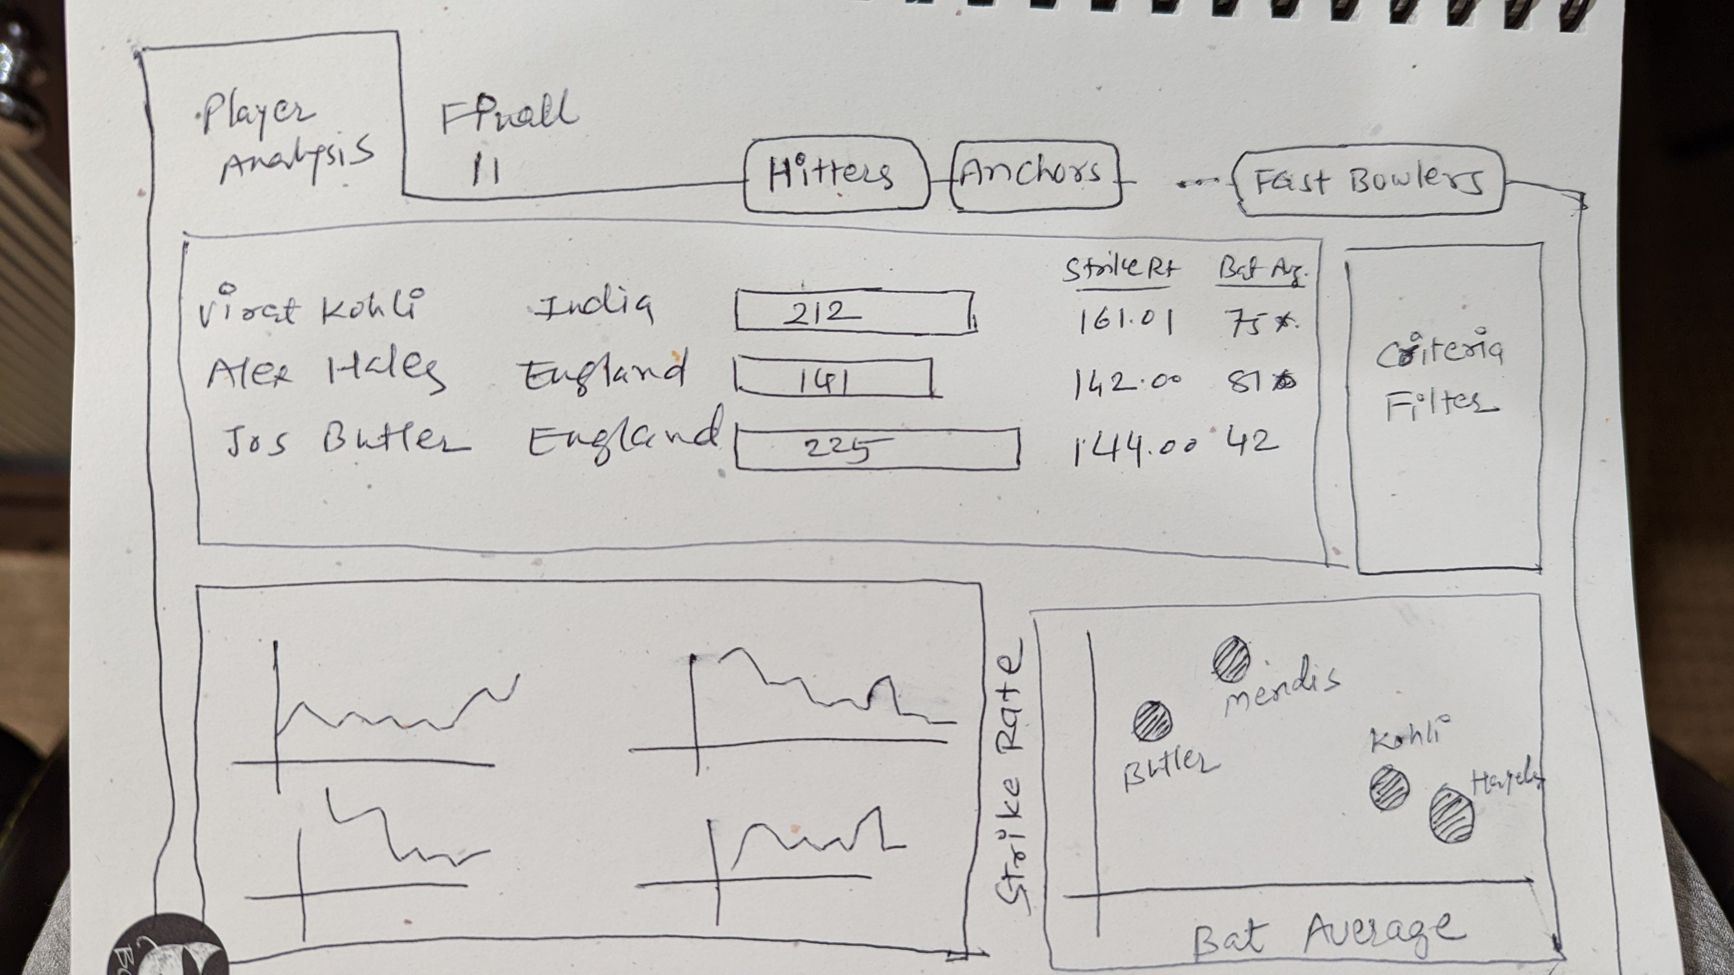

Slide 2
Player Analysis
Navigation between different player roles
Combined Strength of one or more players
Player Analysis with all ‘parameters’ as per player role / position
Criteria Filter
Player Trend for different parameters
Scatter plot of Bat Avg vs Strike rate or other relevant parameters

Slide 3
Final 11
Navigation between Player Analysis & Final 11
Player selection panel with search bar
Final team selection with parameters
Combined team strength on key parameters

Slide 4
Tool Tip when hovered over player name
Player Profile
Batting Stats Per Match
Bowling Stats Per Match

